Slide 1
Heaps
CLRS Chapter 6.1 – 6.3

Slide 2
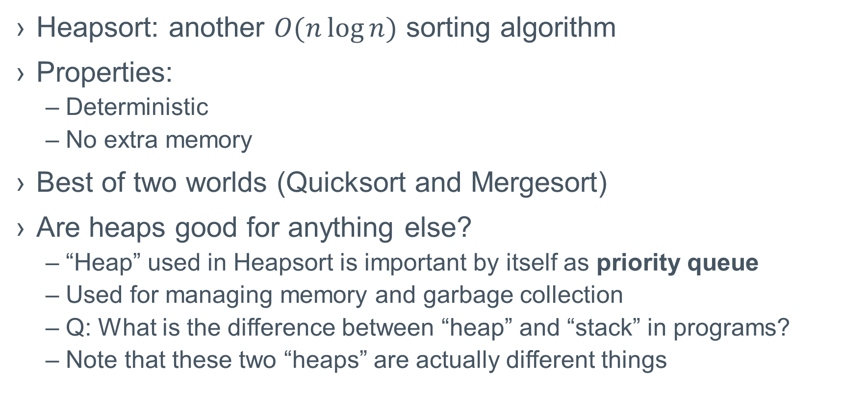
Heapsort: introduction
Heapsort: another $O(n\log{n})$ sorting algorithm
Properties:
Deterministic
No extra memory
Best of two worlds (Quicksort and Mergesort)
Are heaps good for anything else?
“Heap” used in Heapsort is important by itself as priority queue
Used for managing memory and garbage collection
Q: What is the difference between “heap” and “stack” in programs?
Note that these two “heaps” are actually different things

Slide 3
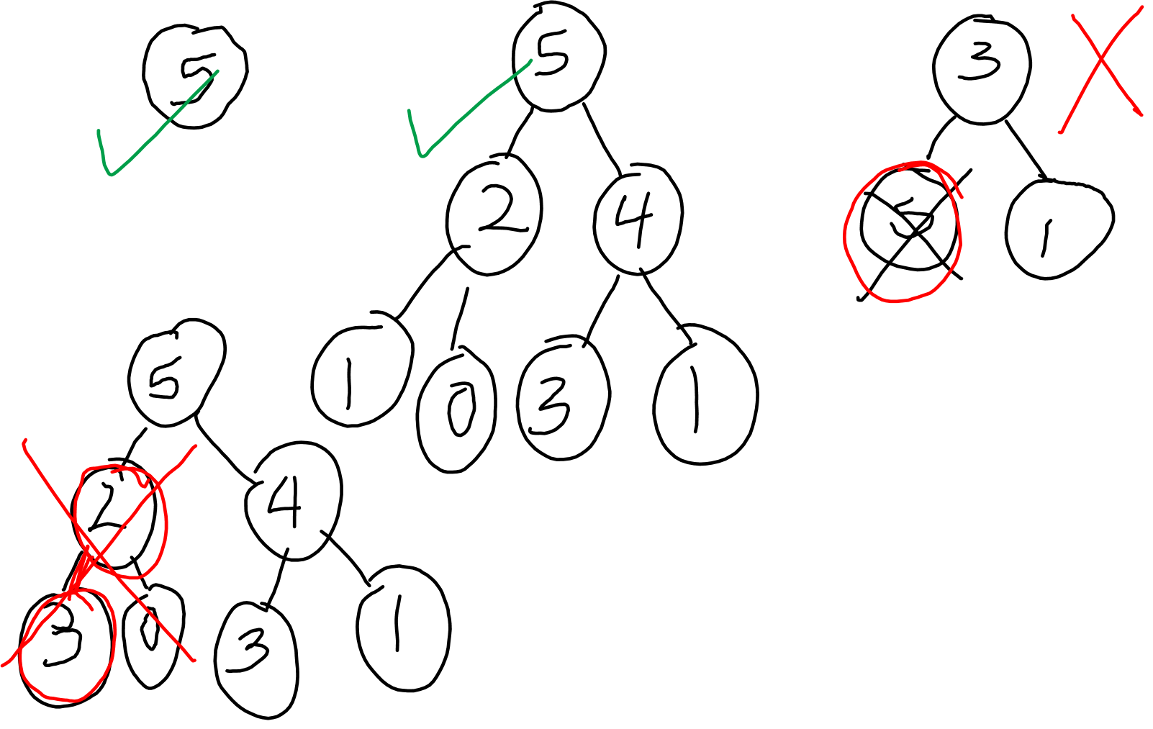

Slide 4
Binary Heaps
Data structure that represents a (nearly complete) binary tree as an array
15
8
12
5
7
11
3
15 | 8 | 12 | 5 | 7 | 11 | 3 | 2 | 1
2
1

Slide 5
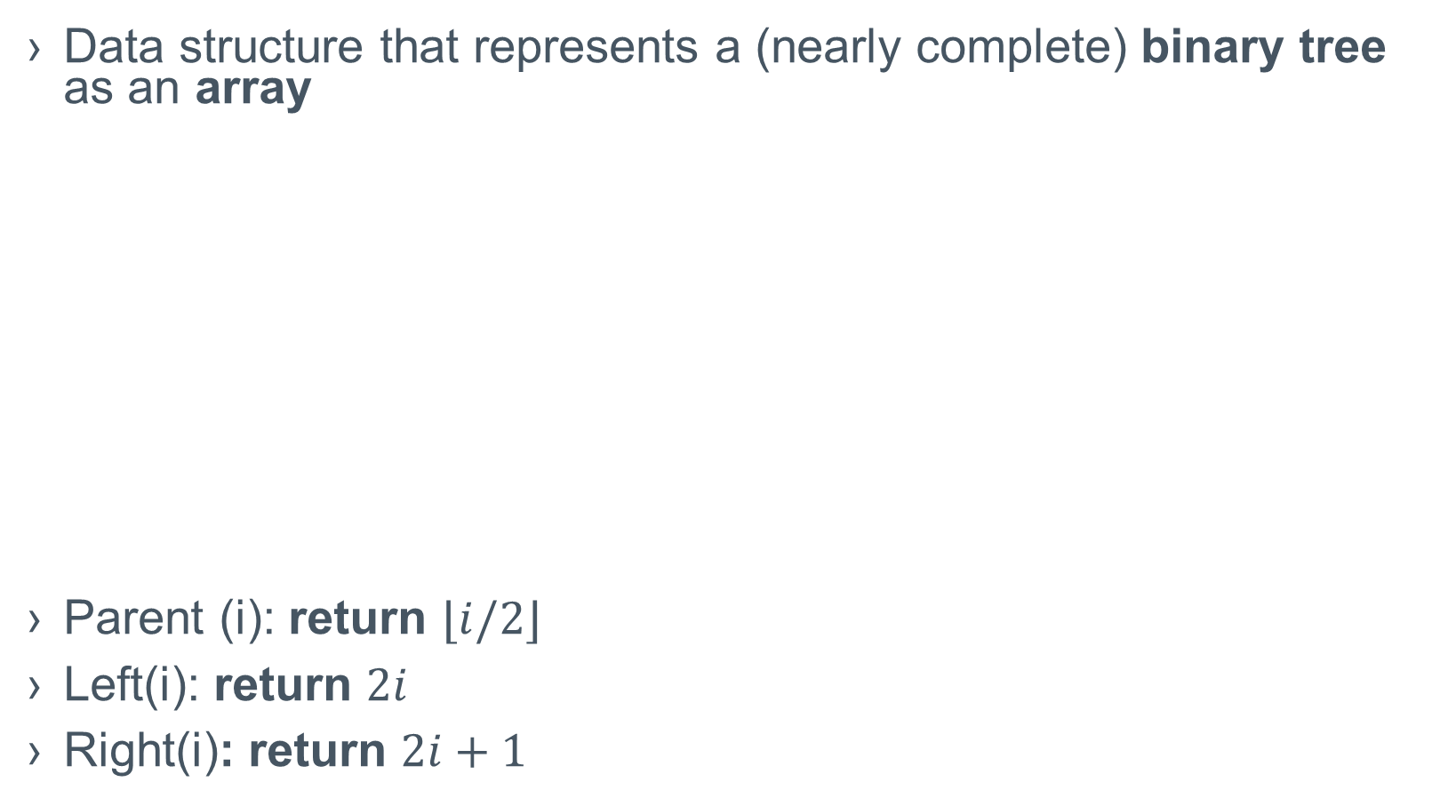
Binary Heaps
Data structure that represents a (nearly complete) binary tree as an array
Parent (i): return $⌊i/2⌋$
Left(i): return $2i$
Right(i): return $2i+1$
15
8
12
5
7
11
3
15 | 8 | 12 | 5 | 7 | 11 | 3 | 2 | 1
2
1

Slide 6
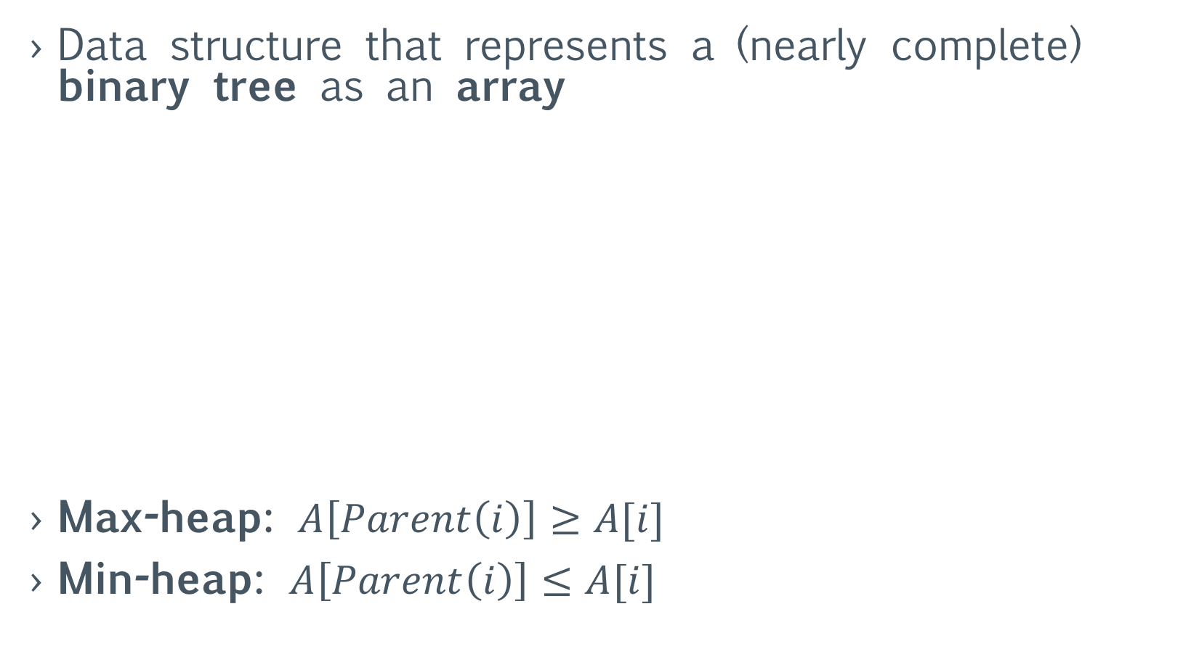
Binary Heaps
Data structure that represents a (nearly complete) binary tree as an array
Max-heap: $A\left[Parent\left(i\right)\right]≥A[i]$
Min-heap: $A\left[Parent\left(i\right)\right]≤A[i]$
15
8
12
5
7
11
3
15 | 8 | 12 | 5 | 7 | 11 | 3 | 2 | 1
2
1

